Slide 1
ACCELRATORS Dr J P Singh Associate Professor Physics PGGC-11, Chandigarh

Slide 2
ACCELERATORS

Slide 3
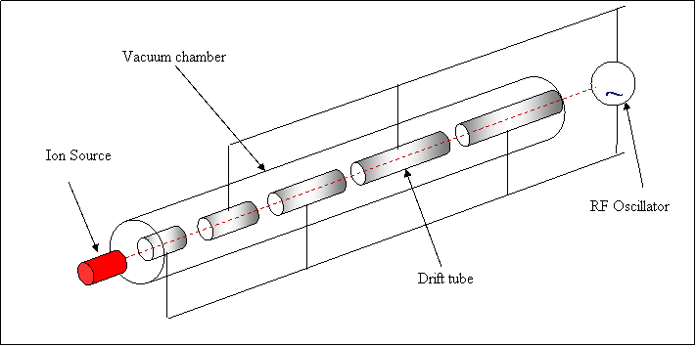
Linear accelerator
Principle. The working of a linear accelerator is based on the following two facts:
When a charged particle is subjected to an alternating electric field, it is accelerated during one half cycle.
(ii) The electric field inside a hollow charged conductor is always zero and a charged particle moves inside it with uniform velocity.

Slide 4
For the acceleration of the ion, the time of transit of ion through the length of a tube must be equal to half the time period of the high frequency alternating voltage supplied by the oscillator. So, each tube must be longer than its preceding one because the accelerated ion travels increasingly longer distance in the same time.
If q and m respectively represents the charge and mass of the ion and V is the average value of potential difference then its velocity v_{n} while entering nth tube is given by
The velocity of the ion is directly proportional to
The time taken by the ion to pass through all the tubes is same and is T/2. Therefore, the length of nth tube is given by

Slide 5
As q, m, V and T are constants, therefore
i.e. the lengths of the tubes1, 2, 3…….are in the ratio of 1,
Advantages:
Linear accelerators are economical when very high energies are required.
(2) These can provide well collimated beam of accelerated, charged particles with high intensity
Disadvantages:
The major disadvantage of the linear accelerator is its large length. To accelerate the charged particles to high energies, number of cylindrical tubes are to be used.

Slide 6
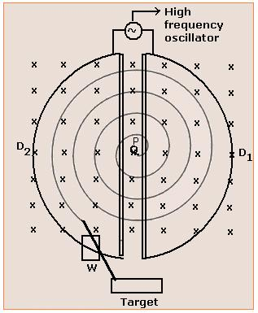
cyclotron
A Cyclotron is a device that accelerates charged particles in a circular path by repeatedly dropping them over a potential difference
Principle: It is based on the principle that charged particles can acquire high energy when they are repeatedly passed through an accelerating electric field along a closed path.
Particle acceleration is achieved using an RF field between “dees” with a constant magnetic field to guide the particles.

Slide 7
Let m = mass of ion to be accelerated
B = magnetic field
q = charge on the ion
v = velocity of ion
r = radius of semi-circular path
The centripetal force required by the ion to move in a circular path is provided by
The perpendicular magnetic field B.
So,
If t is the time required to complete the semi-circular path, then

Slide 8
Cyclotron frequency:
If T is the time period of the charged particle, then
So, the frequency of revolution,
And angular frequency is given by,
Maximum energy of particle:
The final energy of the charged particle is given by,
Now
Hence,

Slide 9
Limitations of Cyclotron:
Uncharged particles can’t be accelerated.
Only heavy charged particles like protons, deutrons, α-particles etc. can be
accelerated. Electron can’t be accelerated because of its small mass and a
small increase in energy makes it move with very high speed, as a result it
goes quickly out of track.
Advantages:
It requires comparatively low voltage source for producing high energy particles.
The accelerated charged particles produced by cyclotron are used for
producing high energy particles like neutrons by collisions.
(iii) The particles produced are used in artificial transmutation of elements.

Slide 10
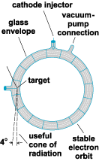
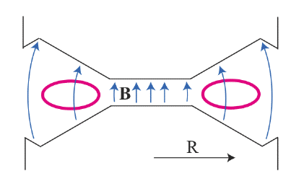
betatron
The betatron is essentially a transformer with a torus-shaped vacuum tube as its secondary coil. An alternating current in the primary coils accelerates electrons in the vacuum around a circular path. The betatron was the first important machine for producing high energy electrons.

Slide 11
The induced e.m.f produced in the circuit by changing magnetic fluxis given by Faraday’s law.
The work done on an electron of charge e in one revolution is given by
W = charge on electron × induced e.m.f
Now,

Slide 12
Combining all equations, we get
This equation is called Betatron condition or flux condition. This shows that the rate of change of magnetic flux within the orbit radius r is always twice that it would have been if the magnetic field intensity were uniform thoroughout thr orbit.

Slide 13
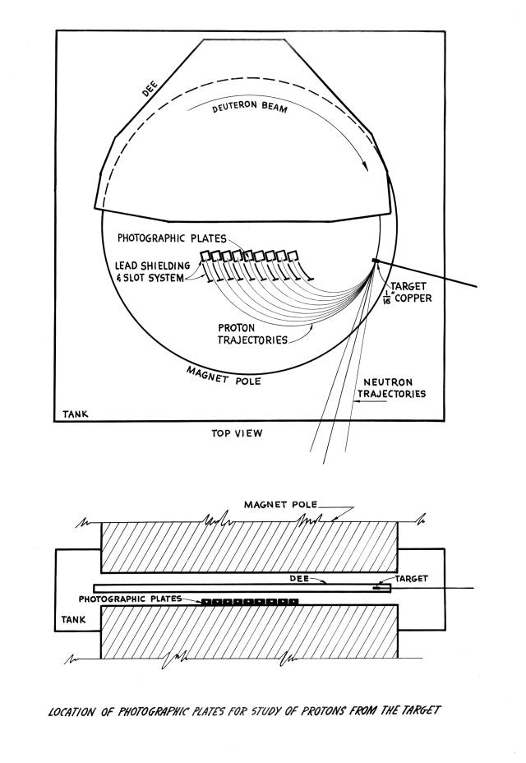
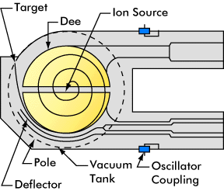
Synchro-cyclotron
The Synchro-cyclotron overcomes the difficulties of cyclotron by decreasing the oscillator frequency to compensate for the changing mass.

Slide 14
The machine in which magnetic field is kept constant and the frequency is varied is known as Synchro-Cyclotron. It can accelerate α-particle upto 400MeV, deutrons upto 200MeV and protons upto 350 MeV.
Advantages:
The efficiency of the oscillator is high at low r.f voltage.
High magnetic pole flux density is obtained by reducing the gap between the magnetic pole faces.
Disadvantages:
Electrons can’t be accelerated.
(ii) The output beam current is very small (1µA) because a small fraction of injected ions are admitted into expanded phase stable orbits of maximum radius and energy.

Slide 15
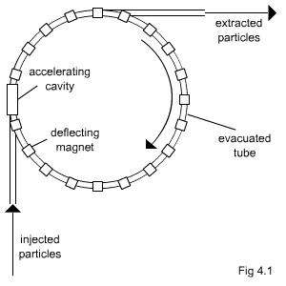
synchrotrons
The orbital accelerator which employs the increasing magnetic induction B in an orbit of constant radius is called synchrotron. There are two types of synchrotrons:
Electron synchrotron
(ii) Proton synchrotron

Slide 16
Electron synchrotron:
The energy of electron having rest mass m_{o} is given by
Since
And the frequency of oscillation is given by

Slide 17
Proton synchrotron:
It is similar to electron synchrotron and is sometimes called Bevatron.
It can be used to accelerate protons, alpha particle, deutrons etc.
The frequency of revolution is given by
In the presence of four straight sectron each of length l, we get
Since total energy,

